Slide 1

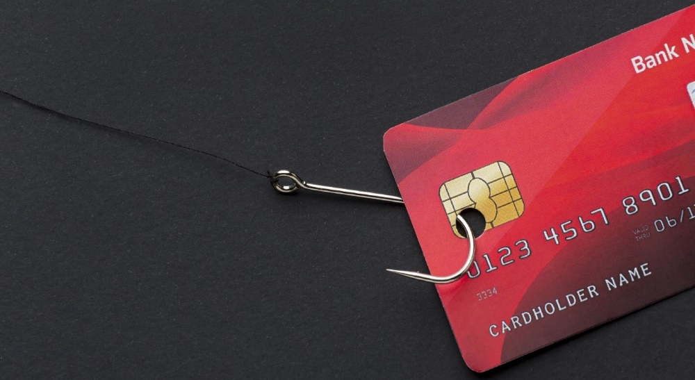

Group 1
Project Submission
Due Friday, june 1st at 1:00pm

Slide 2

PLAN
Team members
Problem
Methodology
Results
Proposed solution
References and appendices

Slide 3


Present Team Members
Jeffking STERILE
Serginau Louis
Flore Ketenie
Kesnel Samuel Jean Philipe

Slide 4


Problem
The bank's problem is one of fraudulent credit card transactions. As a result, it is unable to provide high quality customer service to protect the financial assets of its customers, despite its desire to do so. And media is risquing their reputations

Slide 5
Stakeholders
The bank (profitability, reputation)
It is their duties as their interest to provide high quality service in order to protect the financial assets of their clients and those who invest their money thru the bank, i.e. the shareholders who risk losing their investment. Banks incur substantial operating costs by refunding customers’ monetary losses
The client
This impacts customers’ perception of feeling secure and protected at their bank. It affects customers negatively not only in terms of monetary losses, which are typically refunded by banks, but also in terms of the efforts they have to make to restore the original situation.
The employee
The employee will feel concerned and will struggle of the bank doubts that their jobs or working conditions might were unfair.

Slide 6


Methodology
Firstly, we will collect data for the analysis. We will use the data related to the transactions of the client, which are during 6 months (180 days).

Slide 7

Methodology
Secondly, we will use Python to manipulate the data. We will start by treating the data and use appropriate descriptive statistics such as central tendencies: mean, mode and median as well as frequencies were used for analysis. Figures, tables, graphs and charts were used to present the analysed data for ease of understanding

Slide 8


Methodology
There’s a part of the analyses that is performed only on fraudulent transactions
And then, after visualizing the data with graff, table, we will determine where the most frauds come from and take different measurements to resolve the problem

Slide 9
Resultat
Highlights
The data are collected on 180 days, there are 112 customers concerned in 4112 , 50 merchant, 15 categories of transaction based on purchased.
We have 1.21 % of transaction that are fraudulent, and we have 37.89 average amount of transaction by day .
The average amount of non-fraudulent transactions is 31.8 but the average amount of Fraudulent transactions is 530.92

Slide 10
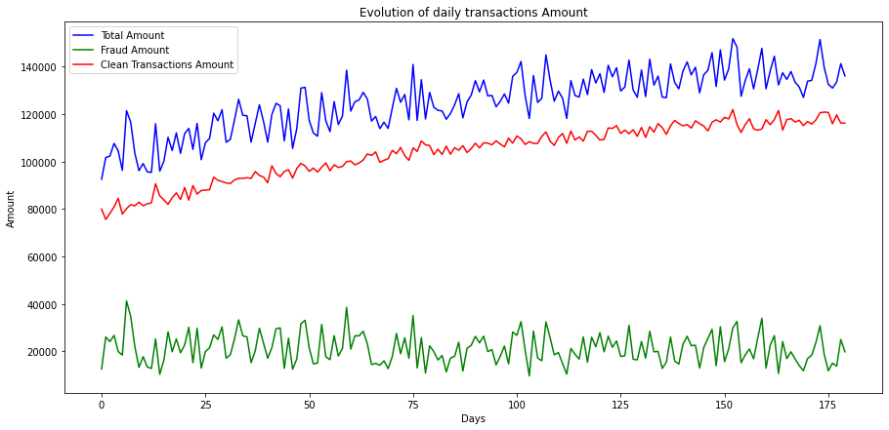
Daily transaction of the amount
While overall transactions are increasing, fraud trends remain the same.

Slide 11
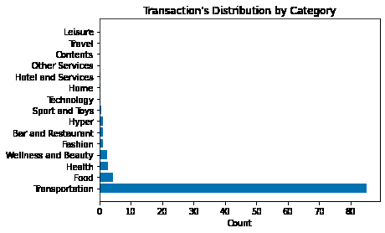
Transportation: 84.94
Food: 4.41
Health: 2.71
Wellness and Beauty: 2.53
Fashion: 1.08

Slide 12
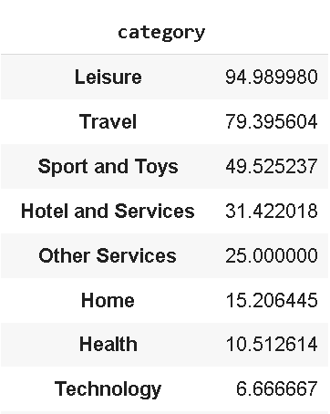
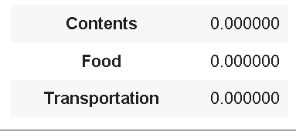
Contents, Food and Transportation don't have fraudulent transactions
At same time, Leisure, Travel are category where most of the transactions are fraudulent.

Slide 13
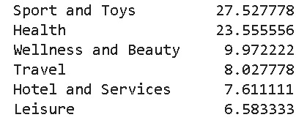
Probability for the transaction to be in this category knowing that it is a fraud.

Slide 14
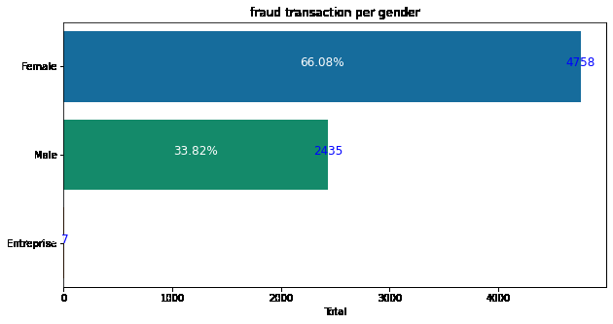
As we can see from the graph,we have more fraudulent transactions that can from women

Slide 15
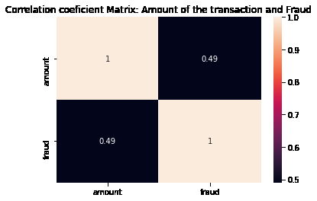
There is a positive correlation between the amount of the transaction and the fact of the fraud

Slide 16
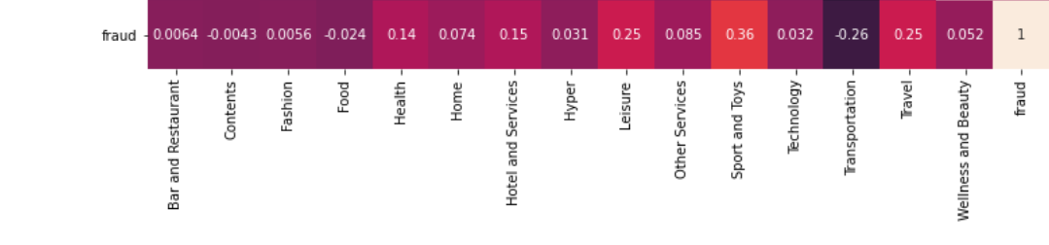

Slide 17
SWOT
Opportunities | Threats
Availability of data’s transaction they can use the result of the business analysis to manage the problem of fraud | profit at risk risk of losing shareholder confidence Negative ads of the media Declining economy (loss of large sums) High risk of competition with other banks Loss of customer confidence
Strengths | Weaknesses
excellent service client Online service client | Low level of fraudulent transactions Lack of credibility on the part of clients Low customer retention Negative publicity from the media transaction level not secured

Slide 18
Discussion
Despite 84% of transactions are in transportation, transportation remains one of the categories that has no fraud.
One of the most important variable for detecting fraude is the amount of the transaction because we have seen the average amount for fraudulent transactions is bigger than non-fraudulent transactions.

Slide 19
Proposed solution
Double check on transactions about travel and leisure if possible.
Block transactions with a high level of amount (over 530) in the 2 categories mentioned above and more security step from female transactions
Doing a model that can predict fraudulent transaction in realtime in order to block possibly fraudulent transaction...

Slide 20
Alternative solution
The bank should put in place a security system that can prevent those way of hacking:
1.1 Phishing (process of attempting to acquire information such as usernames or passwords by masquerading as trustworthy online source.) Solution : advise the customer to avoid links to bogus websites.
1.2 Spoofing ( the act of creating and using an invented story to persuade an individual to provide sensitive informations or perform an action)
Solution: advise the customer If they ever receive an email claiming to be from their card issuer, do not click any links, and call the bank for further information.
1.3 Skimming (an illegal practice used by identity thieves to capture credit card information from a cardholder surreptitiously)

Slide 22
Advantages and Inconvenients
Advantages
Block high level of amount in some category will protect the client from high losses.
An algorithm can make the bank to react faster in case there are frauds
Inconvenients
Make a great algorithm can relatively take time for the unclassified transactions in some categories, we could have to collect the “unknown data”.
Blocks some transactions (who are not fraudulent transactions) will make the client feeling frustrated.

Slide 24
References & Appendices
https://voxeu.org/article/how-banks-affect-investment-and-growth
What is Business Analysis? | Global Standard for Business Analysis Certification | IIBA®
Strength, Weakness, Opportunity, and Threat (SWOT) Analysis Definition (investopedia.com)

